Slide 1
PhD project plan
Daniel Roelfs
Primary supervisor: Tobias Kaufmann

Slide 2
Brain Network Connectivity and Genetics in Schizophrenia

Slide 3
Background
Synaptic functioning is altered in SCZ
Measure synapses using MRI?
Connectivity hypothesis
NMDA & modulatory neurotransmitters
SCZ GWAS
SNPs associated with synaptic connectivity
Connect them all
Notes:
Look at functional connectivity
Genetics linked to genes associated with connectivity

Slide 4
Research Questions
Overarching theme
Uncover mechanisms underlying altered brain connectivity in SCZ

Slide 5
Research Questions
Overarching theme
Uncover mechanisms underlying altered brain connectivity in SCZ
Main questions
Uncover the genetic architecture of the human connectome

Slide 6
Research Questions
Overarching theme
Uncover mechanisms underlying altered brain connectivity in SCZ
Main questions
Uncover the genetic architecture of the human connectome
Link the genetics of the connectome with the genetics of psychiatric disorders, in particular SCZ

Slide 7
Research Questions
Overarching theme
Uncover mechanisms underlying altered brain connectivity in SCZ
Main questions
Uncover the genetic architecture of the human connectome
Link the genetics of the connectome with the genetics of psychiatric disorders, in particular SCZ
Explore altered connections showing strong genetic correlation with psychiatric disorders to data from individuals with the disorder

Slide 8
Methods
UK Biobank
rs-fMRI (+ diffusion)
n = 19 830
TOP
FSL
FreeSurfer
PLINK
LD score regression
Notes:
LD score regression estimates the individual contribution of a SNP to a polygenic trait

Slide 9
Current progress
Article 1
Genetics of the functional connectome in healthy individuals
Take dual-reg files from UKB
Run FSLNets
Partial correlation networks
Regularisation of the edges
Using Ledoit & Wolf shrinkage algorithm
Regress out variables
Run GWAS
LD score regression
Correlation with SCZ GWAS
Notes:
Regularisation of partial correlation networks basically tones down small correlations, so that the strong connections are more present, and the small correlations get smaller, i.e. the noise level is dampened. The extent of regularisation depends on a parameter lambda. Typically, lambda for shrinkage reduction is selected, L&W method calculates it from the data, removing somewhat arbitrary selection process

Slide 10
Article 1
Notes:
Regularisation of partial correlation networks basically tones down small correlations, so that the strong connections are more present, and the small correlations get smaller, i.e. the noise level is dampened. The extent of regularisation depends on a parameter lambda. Typically, lambda for shrinkage reduction is selected, L&W method calculates it from the data, removing somewhat arbitrary selection process

Slide 11
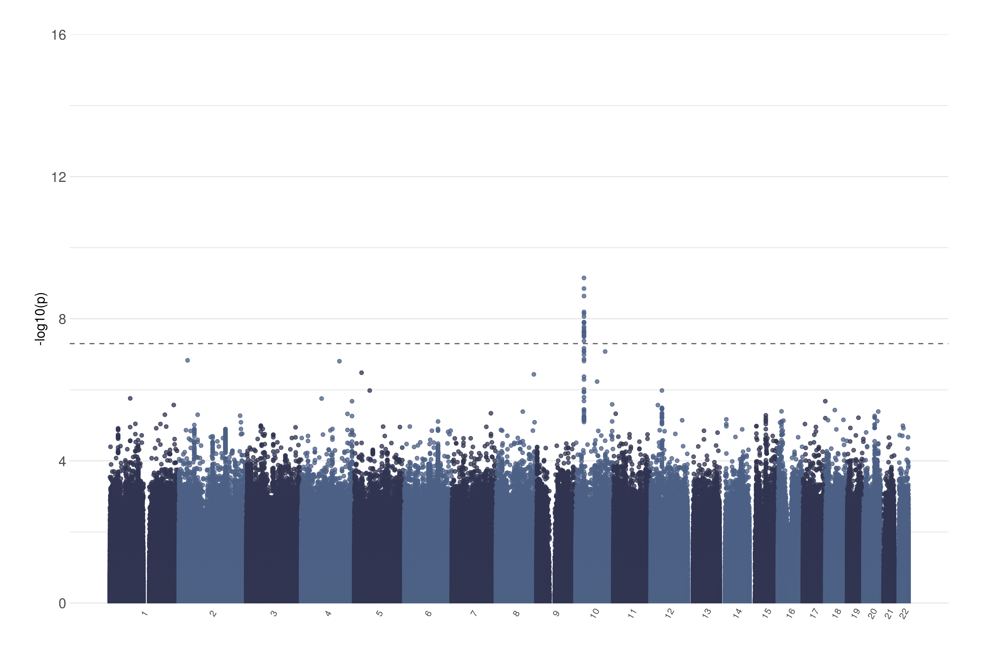
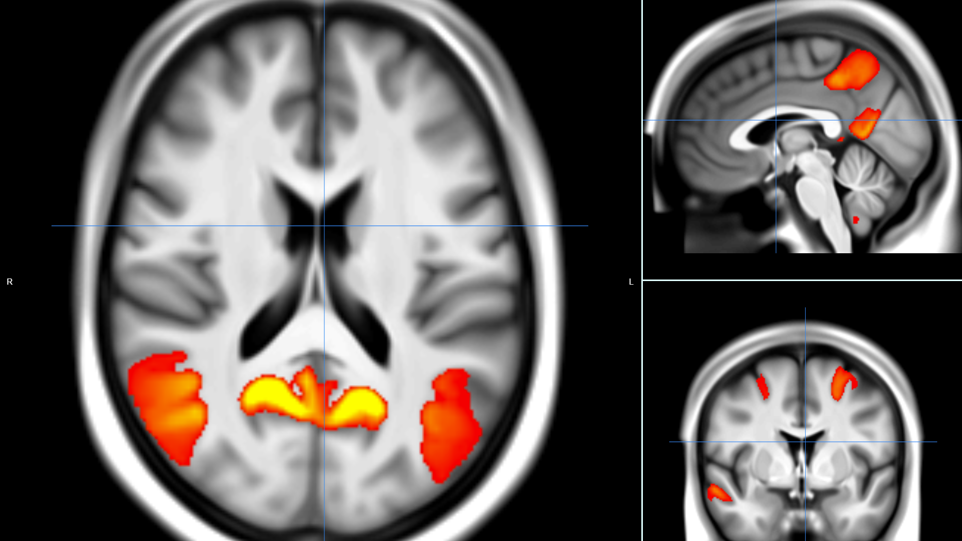
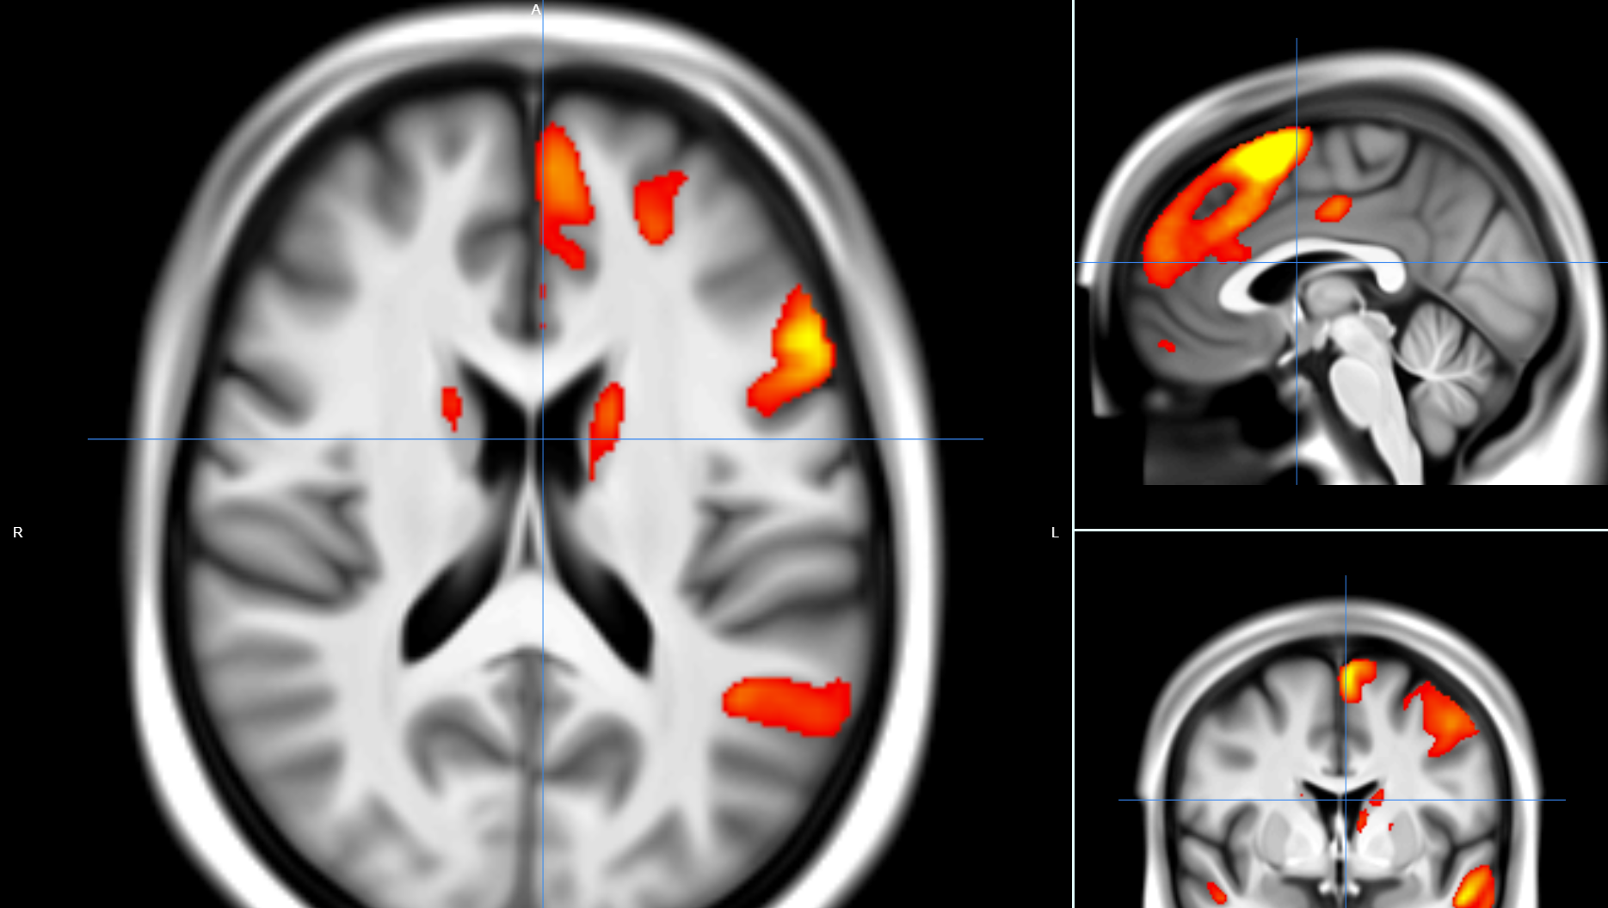
GWAS
Notes:
DMN x Ventral stream/auditory

Slide 12
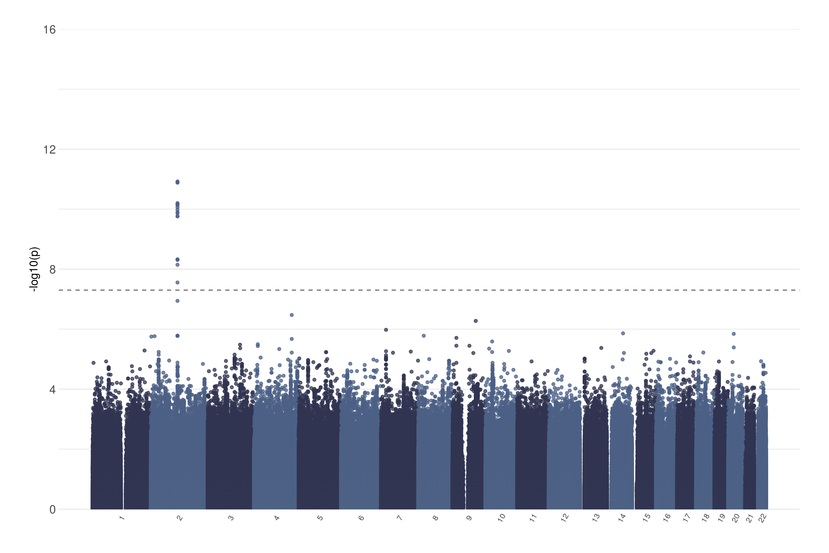
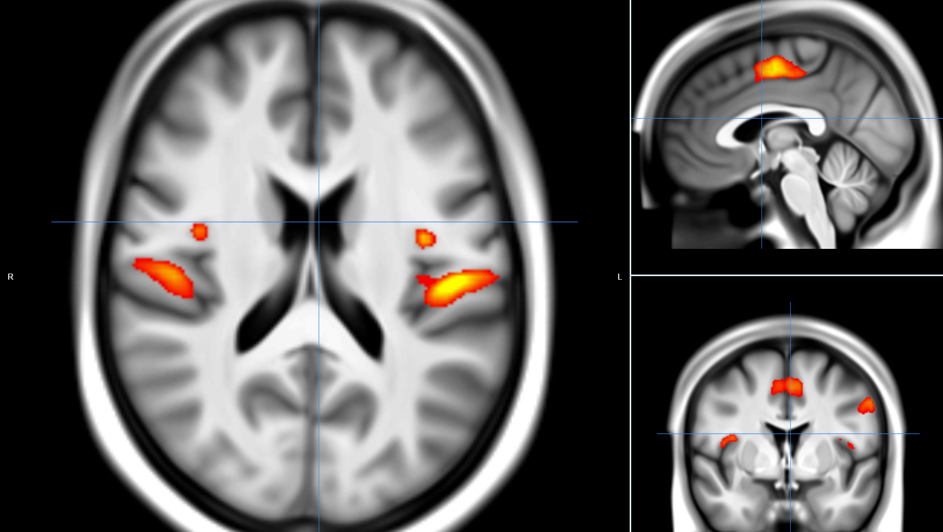
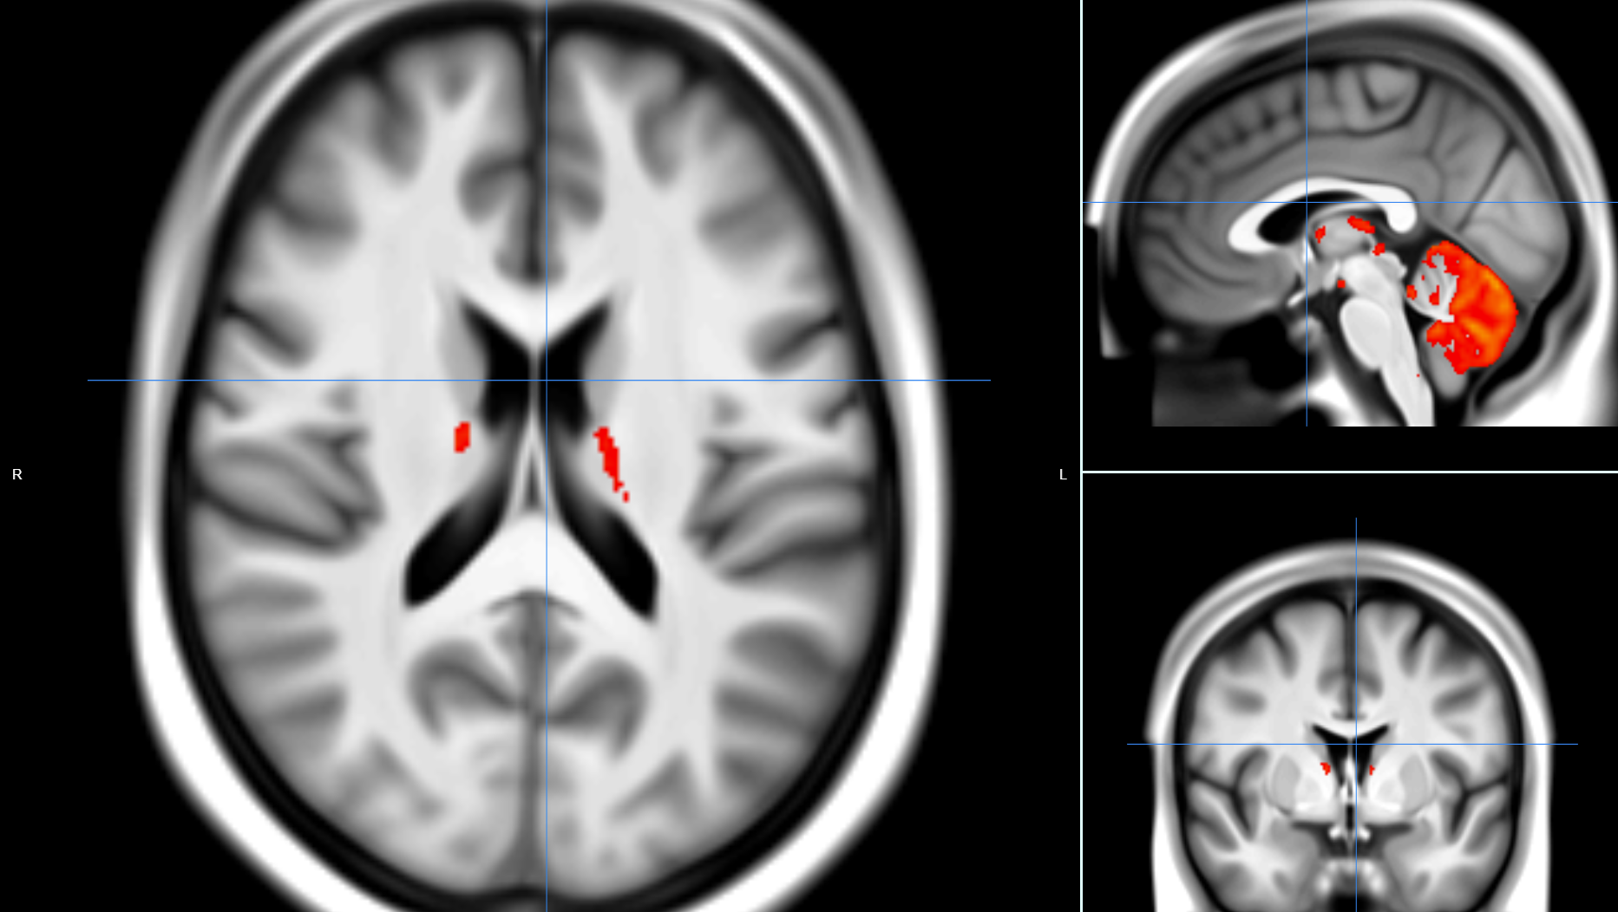
GWAS
Notes:
Somatosensory x Cerebellum

Slide 13
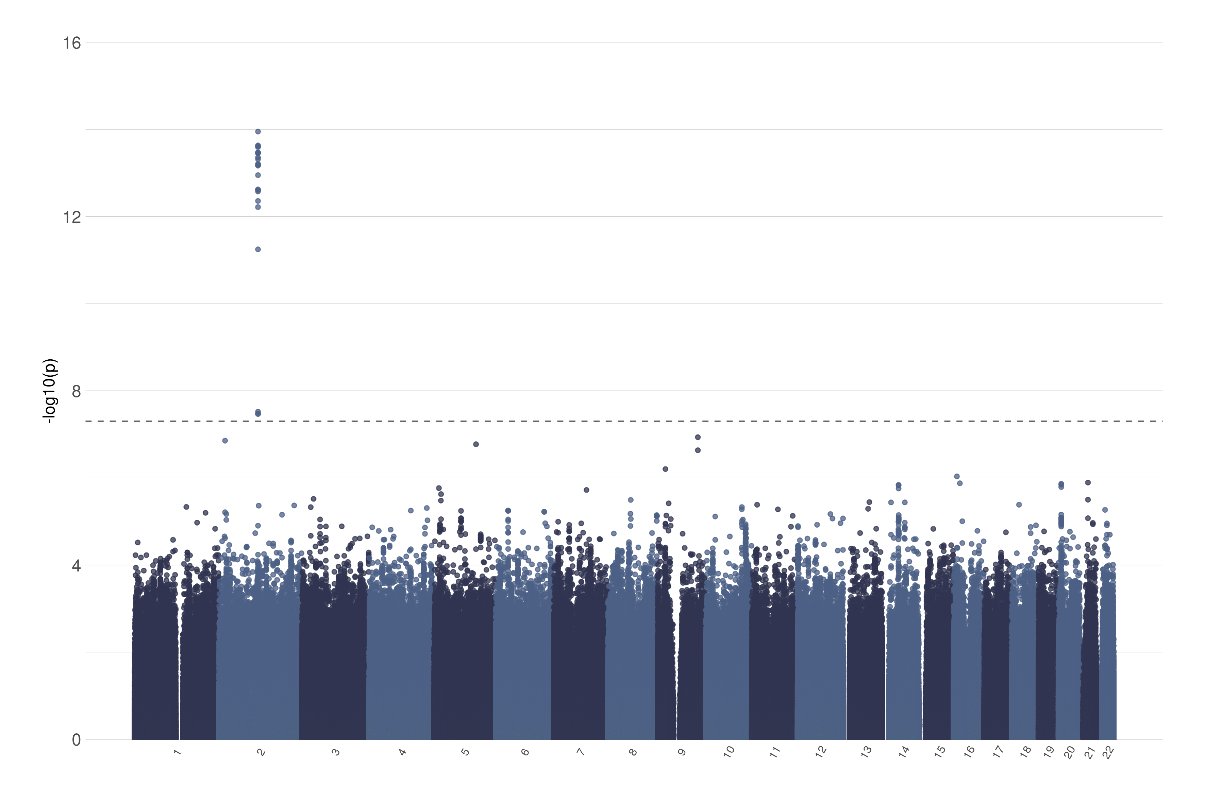
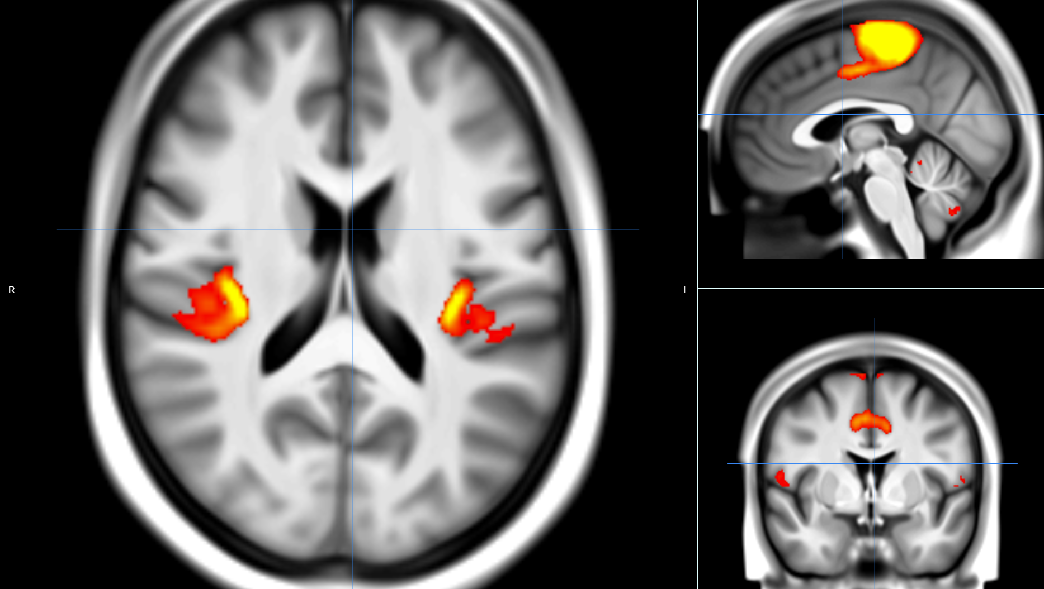
GWAS
Notes:
Somatosensory x Cerebellum

Slide 14
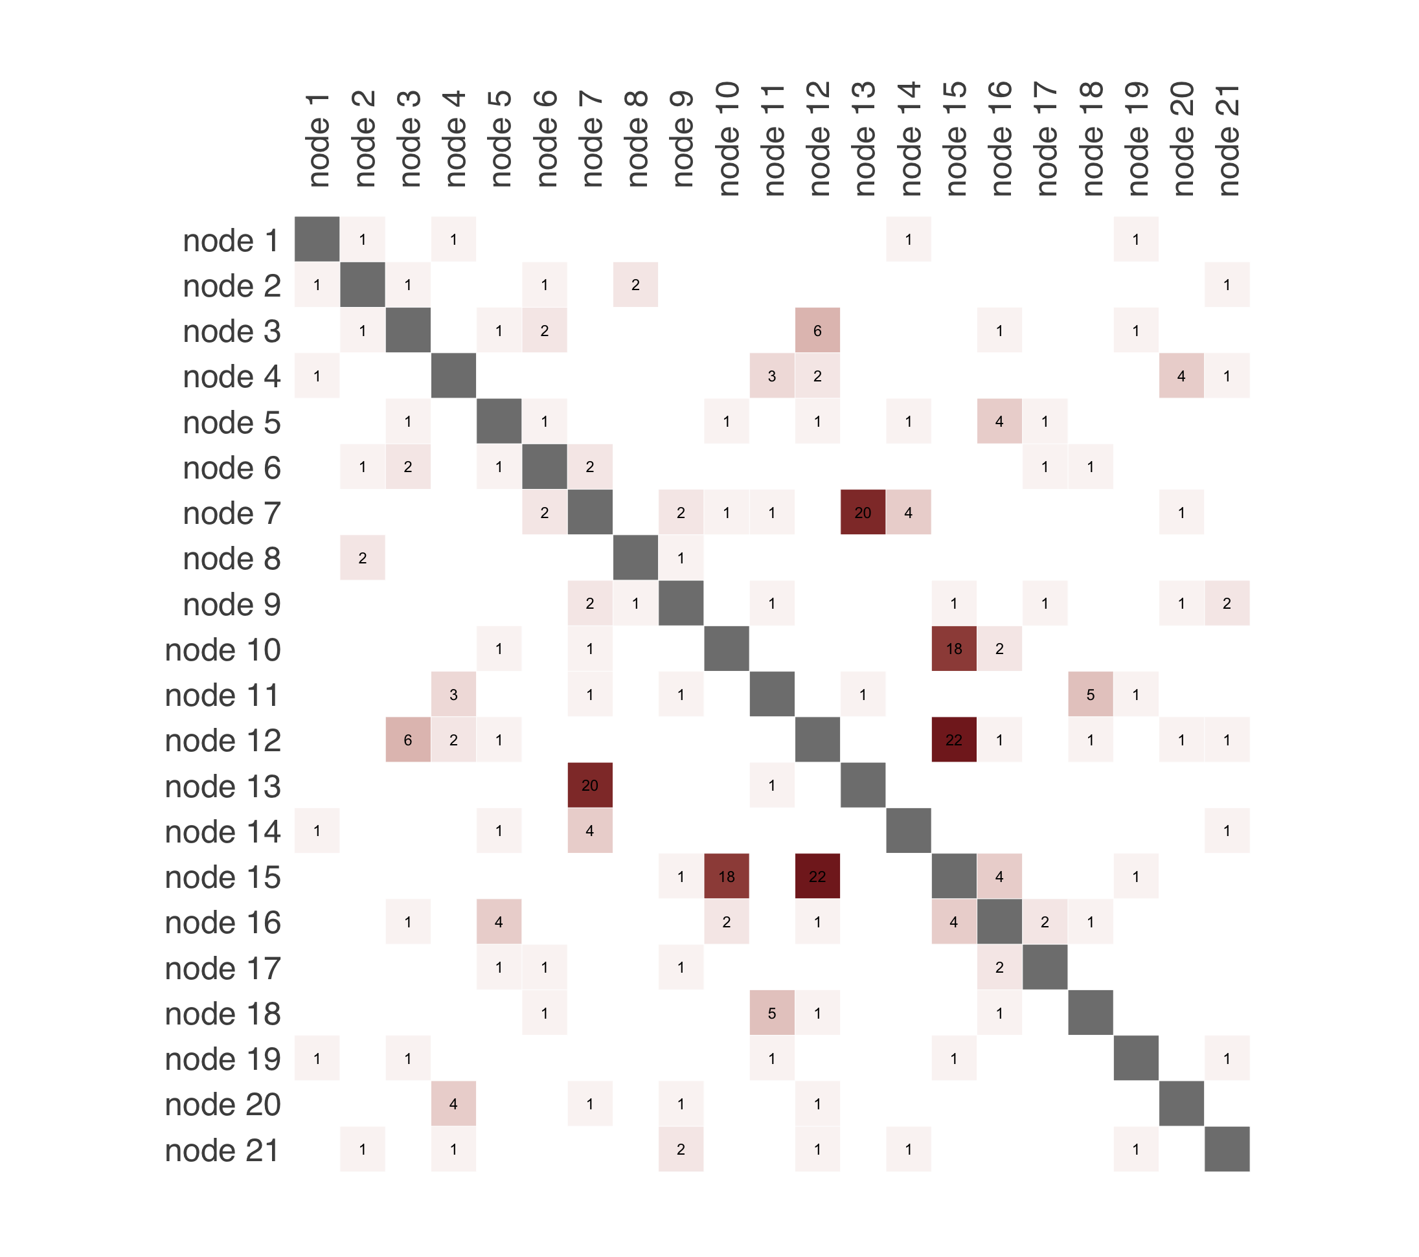
Heatmap significant SNPs

Slide 15
Article 1
Notes:
Regularisation of partial correlation networks basically tones down small correlations, so that the strong connections are more present, and the small correlations get smaller, i.e. the noise level is dampened. The extent of regularisation depends on a parameter lambda. Typically, lambda for shrinkage reduction is selected, L&W method calculates it from the data, removing somewhat arbitrary selection process

Slide 16
Timeline

Slide 17
Thank you!

